Slide 1
Pointer Data Type and Pointer Variables
Pointer variable: content is a memory address
No name associated with the pointer data type in C++ → how do you declare pointer variables?
The value of a pointer variable is an address. That is, the value refers to another memory space. The data is typically stored in this memory space. Therefore, when you declare a pointer variable, you also specify the data type of the value to be stored in the memory location pointed to by the pointer variable.

Slide 2
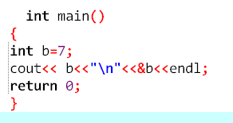

Example

Slide 3

Declaring Pointer Variables
Syntax:
Examples:
int *p;
char *ch;
These statements are equivalent:
int *p;
int* p;
int * p;

Slide 4
Declaring Pointer Variables (cont’d.)
In the statement:
int* p, q;
Only p is a pointer variable
q is an int variable
To avoid confusion, attach the character * to the variable name:
int *p, q;
int *p, *q;

Slide 5
Address of Operator (&)
Address of operator (&):
A unary operator that returns the address of its operand
Example:
int x;
int *p;
p = &x;
Assigns the address of x to p

Slide 6
Dereferencing Operator (*)
Dereferencing operator (or indirection operator):
When used as a unary operator, * refers to object to which its operand points
Example:
cout << *p << endl;
Prints the value stored in the memory location pointed to by p

Slide 7
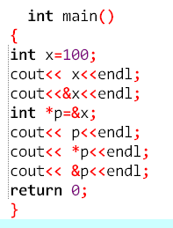
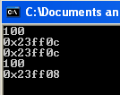

Slide 8
Initializing Pointer Variables
C++ does not automatically initialize variables
Pointer variables must be initialized if you do not want them to point to anything
Initialized using the null pointer: the constant value 0
Or, use the NULL named constant
The number 0 is the only number that can be directly assigned to a pointer variable

Slide 9
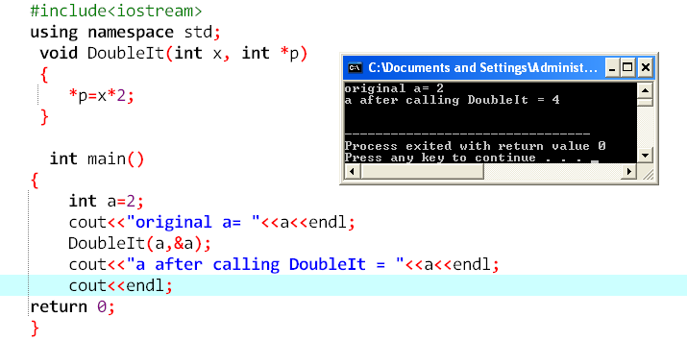
Pointer in Function Call

Slide 10
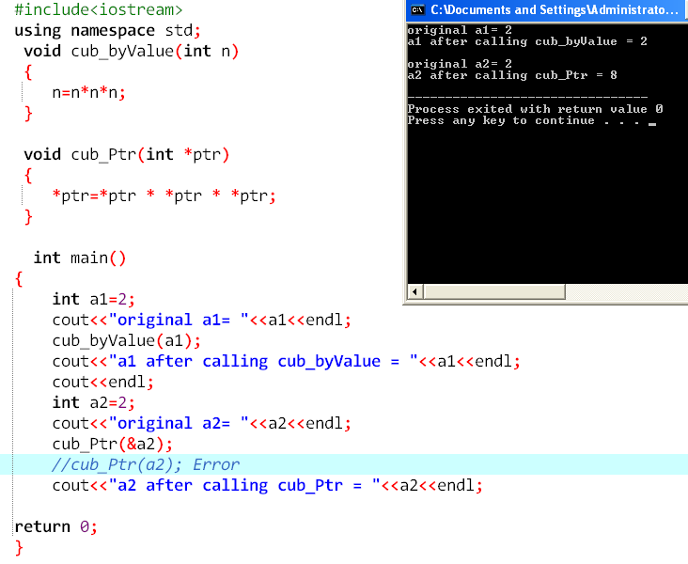

Slide 11
Dynamic Variables
Dynamic variables: created during execution
C++ creates dynamic variables using pointers
new and delete operators: used to create and destroy dynamic variables
new and delete are reserved words in C++

Slide 12
Operator new
new has two forms:
intExp is any expression evaluating to a positive integer
new allocates memory (a variable) of the designated type and returns a pointer to it
The allocated memory is uninitialized

Slide 13
Operator new (cont’d.)
Example: p = new int;
Creates a variable during program execution somewhere in memory
Stores the address of the allocated memory in p
To access allocated memory, use *p
A dynamic variable cannot be accessed directly
Because it is unnamed

Slide 14
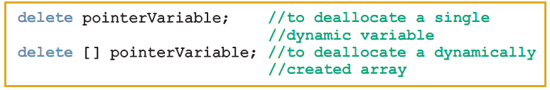
Operator delete (cont’d.)
Memory leak: previously allocated memory that cannot be reallocated
To avoid a memory leak, when a dynamic variable is no longer needed, destroy it to deallocate its memory
delete operator: used to destroy dynamic variables
Syntax:

Slide 15
Operations on Pointer Variables
Assignment: value of one pointer variable can be assigned to another pointer of same type
Relational operations: two pointer variables of same type can be compared for equality, etc.
Some limited arithmetic operations:
Integer values can be added and subtracted from a pointer variable
Value of one pointer variable can be subtracted from another pointer variable

Slide 16
Operations on Pointer Variables (cont’d.)
Pointer arithmetic can be very dangerous:
Program can accidentally access memory locations of other variables and change their content without warning
Some systems might terminate the program with an appropriate error message
Always exercise extra care when doing pointer arithmetic

Slide 17
Dynamic Arrays
Dynamic array: array created during program execution
Example:
int *p;
p = new int[10];
*p = 25;
p++; //to point to next array component
*p = 35;
stores 25 into the first memory location
stores 35 into the second memory location

Slide 18
Operator new (cont'd.)

Slide 19
Operator new (cont'd.)
new allocates memory space of a specific type and returns the (starting) address of the allocated memory space
If new is unable to allocate the required memory space, then it throws bad_alloc exception
If this exception is not handled, it terminates the program with an error message

Slide 20

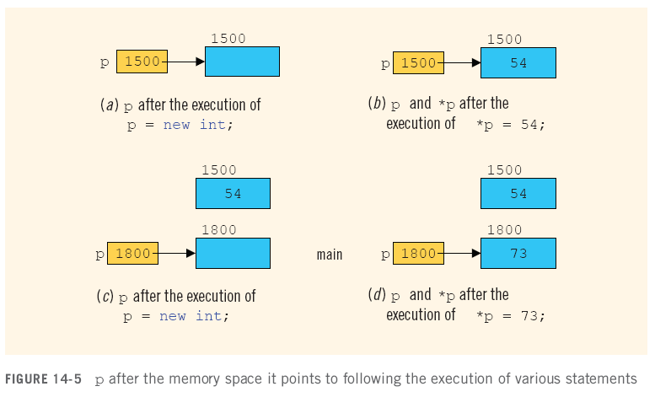
Operator delete

Slide 21
Operator delete (cont'd.)
To avoid memory leak, when a dynamic variable is no longer needed, destroy it
Deallocate its memory
delete is used to destroy dynamic variables
Syntax:
Tip: to avoid dangling pointers, set variable to NULL afterwards

Slide 22
Operations on Pointer Variables
Assignment: value of one pointer variable can be assigned to another pointer of same type
Relational operations: two pointer variables of same type can be compared for equality, etc.
Some limited arithmetic operations:
Integer values can be added and subtracted from a pointer variable
Value of one pointer variable can be subtracted from another pointer variable

Slide 23
Operations on Pointer Variables (cont'd.)
Examples:
int *p, *q;
p = q;
In this case, p == q will evaluate to true, and p != q will evaluate to false
int *p
double *q;
In this case, q++; increments value of q by 8, and p = p + 2; increments value of p by 8

Slide 24
Operations on Pointer Variables (cont'd.)
Pointer arithmetic can be very dangerous
The program can accidentally access the memory locations of other variables and change their content without warning
Some systems might terminate the program with an appropriate error message
Always exercise extra care when doing pointer arithmetic

Slide 25
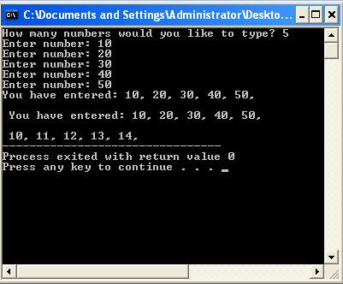
#include <iostream>
using namespace std;
int main ()
{
int i,n;
int * p;
cout << "How many numbers would you like to type? ";
cin >> i;
p= new int[i];
for (n=0; n<i; n++)
{
cout << "Enter number: ";
cin >> p[n];
}
cout << "You have entered: ";
for (n=0; n<i; n++)
cout << p[n] << ", ";
cout << "\n \n You have entered: ";
for (int a=0; a<i; a++)
cout << *(p+a) << ", ";
cout << "\n \n ";
for (int a=0; a<i; a++)
cout << *p+a << ", ";
delete[] p;
return 0;
}

Slide 26
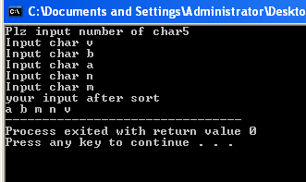
#include<iostream>
using namespace std;
void Sort(char *,int);
int main()
{
char letter;
int size;
cout<<"Plz input number of char";
cin>>size;
char *p;
p= new char[size];
for(int i=0;i<size;i++)
{
cout<<"Input char ";
cin>>letter;
p[i]=letter;
}
Sort(p,size);
cout<<"your input after sort\n";
for(int j=0;j<size;j++)
cout<<p[j]<<" ";
return 0;
}
void Sort(char * a,int size)
{
char temp;
for(int pass =0;pass<size-1;pass++)
for(int i=0;i<size-1;i++)
if(a[i]>a[i+1])
{
temp =a[i];
a[i]=a[i+1];
a[i+1]=temp;
}
}

